Slide 1
Announcement
Start planning for project proposal!
Team size: 1~2 persons
Proposal due on November 22 (11/22)
  Moodle 討論區貼文、組隊
Final Demo on December 20 (12/20)
  exact time and location to be announced

Slide 2
Project Suggestions
Recommended Topics:
  Accelerate the intersection test with a kd-tree or BVH implementation.
  Implement Monte Carlo Path Tracing with Direct Lighting or Multiple Importance Sampling.
  Photon Mapping (with simplified photon caching and final gathering).
Any other rendering project that is related to this course.

Slide 3
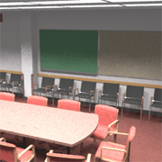
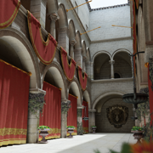
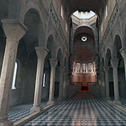
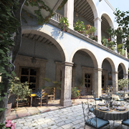
Example of Large Scenes
Conference Room, Sponza, Sibenik, San Miguel, …etc. from McGuire Graphics Data (http://casual-effects.com/data/)
Materials and textures may be ignored.

Slide 4
Acceleration by KD-Tree or BVH
May consider all complex scenarios:
  Exception cases like Intersection out of the bounding volume.
  Degenerate cases of orthogonal rays.
  Speedup of recursive rays (reflection and distributed rays)

Slide 5
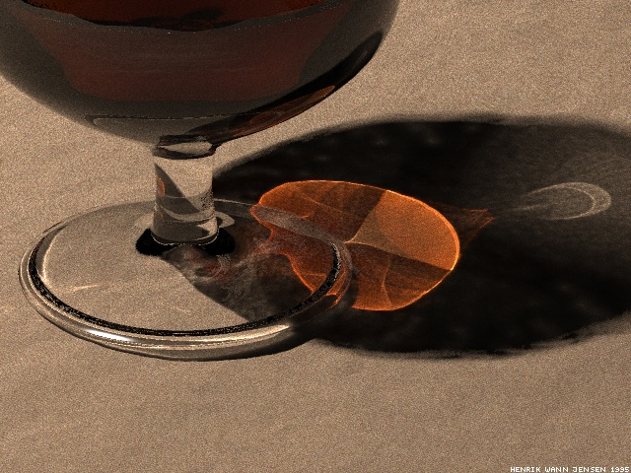
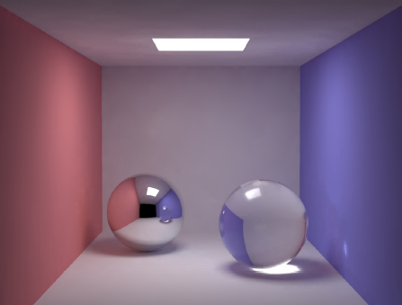
Photon Map
Further reading: SIGGRAPH 2008 Course at http://dx.doi.org/10.1145/1401132.1401136

Slide 6
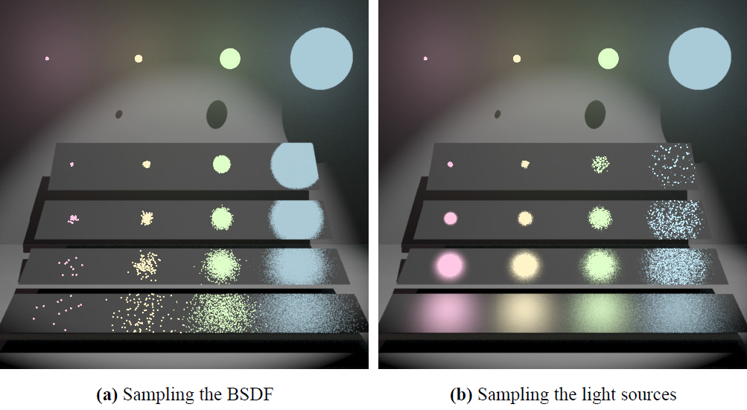
Multiple Importance Sampling

Slide 7
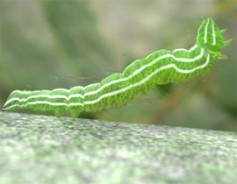
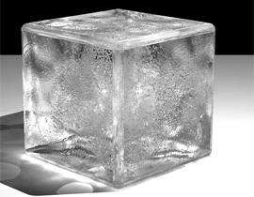
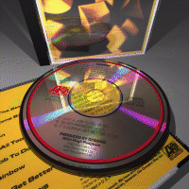
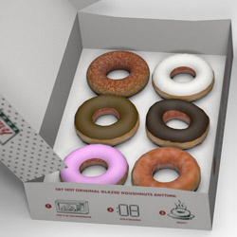
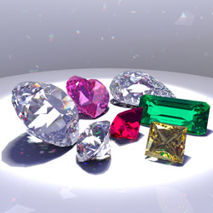
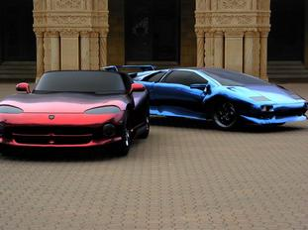
Stanford Rendering Competition

Slide 8
Other Courses
CG @U. Penn.
  http://cg.cis.upenn.edu/index.html
  Final projects of CIS 565 GPU Programming and Architecture: https://cis565-fall-2021.github.io/projects/

Slide 9
Photon Mapping
See Pharr’s PBRT 2nd Ed., Section 15.6 or SIGGRAPH 2008 Course, Advanced Global Illumination using Photon Mapping

Slide 10
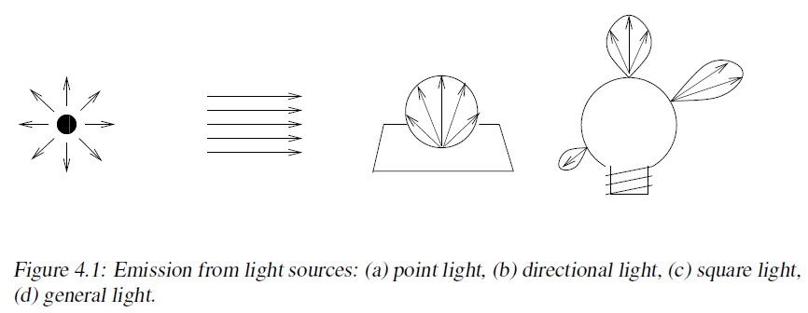
Step 1: Photon Emmision
From: SIGGRAPH 2008 Course, Advanced Global Illumination using Photon Mapping Figure 4.1

Slide 11
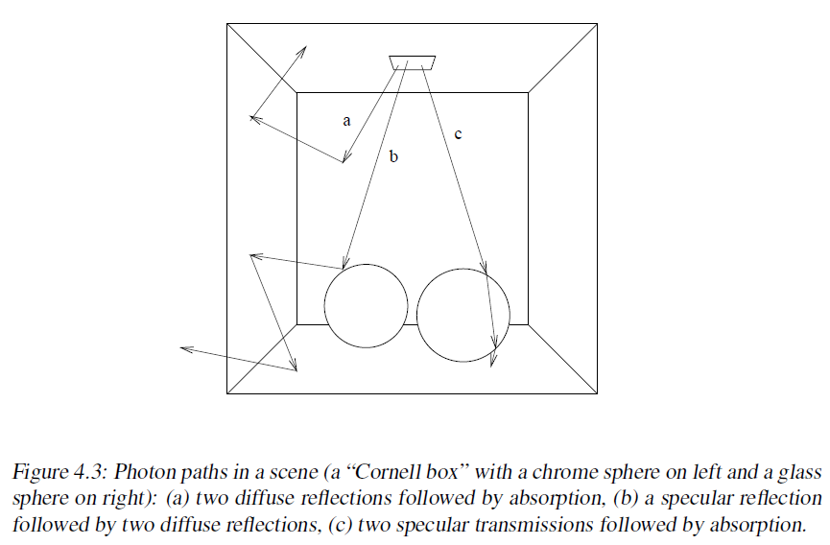
Step 2: Photon Tracing
From: SIGGRAPH 2008 Course, Advanced Global Illumination using Photon Mapping Figure 4.3

Slide 12
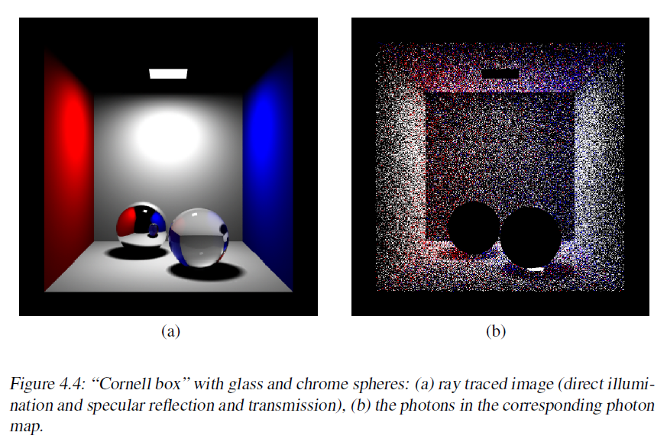
Step 3: Photon Storing
From: SIGGRAPH 2008 Course, Advanced Global Illumination using Photon Mapping Figure 4.4

Slide 13
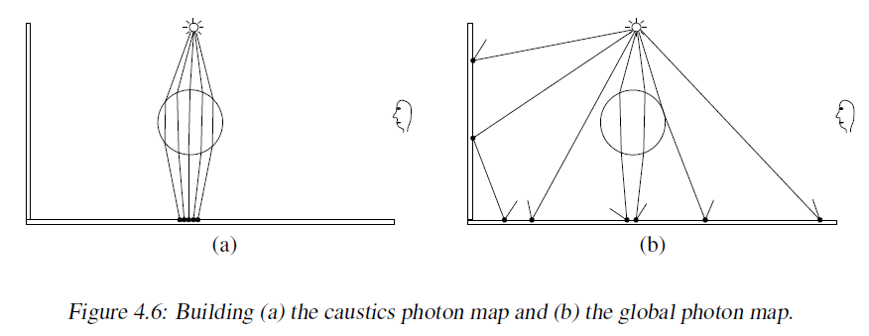
Caustic vs. Global Photon Maps
From: SIGGRAPH 2008 Course, Advanced Global Illumination using Photon Mapping Figure 4.6

Slide 14
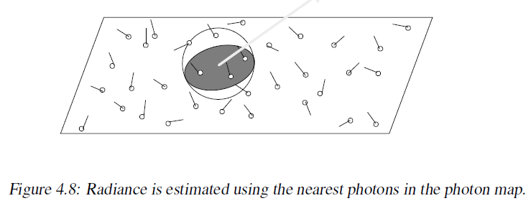
Step 4: Radiance Estimate
Some call this “vertex merging”
From: SIGGRAPH 2008 Course, Advanced Global Illumination using Photon Mapping Figure 4.8

